Slide 1
Team Name : Team Innovators
Team Details: Santhoshri S
Subashree R
Abinaya S
Topic: Social Shopping Integration

Slide 2
Problem Statement
Develop a social shopping platform that integrates directly with popular social media apps for seamless browsing and purchasing. Enhance user experience with personalized product recommendations and secure, in-app transactions. Optimize for mobile accessibility to cater to on-the-go shoppers, ensuring a user-friendly interface. Foster community engagement by enabling easy sharing of purchases and recommendations within social networks. Implement interactive features like live product demos to boost user interaction and satisfaction. Aim to create a unified, efficient environment where social networking meets e-commerce seamlessly.

Slide 3
Solution
Our solution for social shopping integration involves developing a robust platform that seamlessly merges social media and e-commerce. Users can browse and purchase products directly within their favorite social media apps, enhancing convenience and accessibility. The platform will feature personalized recommendations based on user preferences and social interactions, facilitating a tailored shopping experience. Secure payment gateways and real-time customer support ensure trust and reliability. Interactive elements such as live product demos and user-generated content will boost engagement and satisfaction.
Ultimately, our goal is to create a cohesive environment where social interaction and shopping converge seamlessly, revolutionizing the online shopping experience.

Slide 4
Benefits
Convenience: Social shopping integration allows users to browse and purchase products without leaving their favorite social media platforms, streamlining the entire shopping experience.
Personalization: Users receive personalized product recommendations based on their social media activity, interests, and past purchases, enhancing relevance and satisfaction.
Enhanced Engagement: Interactive features such as live product demonstrations, user reviews, and social sharing capabilities encourage active participation and interaction among users, boosting engagement.
Trust and Security: Integrated payment gateways and secure transactions within social media platforms ensure a safe and trustworthy shopping environment, reducing friction in the buying process.

Slide 5
Advantage
Enhanced User Experience: Users can shop directly from their social media feeds, making the shopping process more convenient and intuitive.
Personalized Recommendations: Integration allows for personalized product suggestions based on users' social interactions and preferences, improving relevance and satisfaction.
Increased Engagement: Interactive features such as user reviews, ratings, and social sharing options foster higher user engagement and interaction with products and brands.
Community Influence: Users can share their purchases and recommendations with friends and followers, leveraging social influence to drive purchasing decisions and brand advocacy.
Streamlined Transactions: Integrated payment systems within social platforms
facilitate quick and secure transactions, enhancing convenience and trust for users

Slide 6
Disadvantage
Privacy Concerns: Integrating shopping with social media may raise privacy issues as personal data and shopping habits are linked and potentially shared across platforms.
Information Overload: Users may feel overwhelmed by the constant stream of product recommendations and promotional content within their social media feeds, leading to fatigue or reduced engagement.
Security Risks: Integrated payment systems within social platforms could pose security risks if not adequately protected, potentially exposing users to fraud or data breaches.
Distraction: The blend of social interaction and shopping could lead to distractions and reduced productivity as users may spend more time browsing products rather than engaging in meaningful social interactions.
Dependency on Platform Stability: Businesses relying heavily on social shopping integration are vulnerable to changes in platform policies, algorithms, or technical issues that could disrupt operations or impact sales.

Slide 7
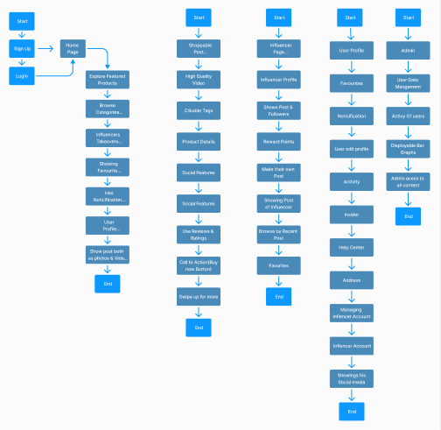
Flow Chart

Slide 8
Prototype of figma
https://www.figma.com/proto/ZnpdZzg0jECMcwdcdaU6OF/Untitled?page-id=0%3A1&node-id=203-2072&viewport=270%2C159%2C0.16&t=ahI7tGP5r6ys20lz-1&scaling=scale-down&content-scaling=fixed&starting-point-node-id=116%3A563&show-proto-sidebar=1

